Slide 1
Single-Source Shortest Path, All pair Shortest Path
SUBMITTED BY :- ABHINAV SINGH
ROLL NO. – 181210001
CSE 2ND YEAR (GROUP-1)

Slide 2
SINGLE-SOURCE SHORTEST PATH:-
SINGLE-SOURCE SHORTEST PATH
Single Destination Shortest Path Problem : Find a shortest path from the given destination vertex t to the vertex v. By reversing the direction of each edge in the graph we can reduce each problem to single-source problem.
Single Pair Shortest Path Problem : Find a shortest path from u to v for given vertices u and v. If we solve the single-source problem with source vertex u, we solve this problem also.

Slide 3
DIJKSTRA’S ALGORITHM :-
SINGLE SOURCE SHORTEST PATH-DIJKSTRA’S ALGORITHM
Dijkstra’s algorithm solves the single-source shortest-paths problem on a weighted, directed graph G = (V,E) for the case in which all edge weights are nonnegative.
Dijkstra’s algorithm maintains a set S of vertices whose ﬁnal shortest-path weights from the source s have already been determined.
The algorithm repeatedly selects the vertex u є V - S with the minimum shortest-path estimate, adds u to S, and relaxes all edges leaving u.
In the following implementation, we use a min-priority queue Q of vertices, keyed by their d values.

Slide 4
ALGORITHM :-
SINGLE SOURCE SHORTEST PATH-DIJKSTRA’S ALGORITHM
DIJKSTRA(G,w,s)
INITIALIZE-SINGLE-SOURCE(G,s)
S = 
Q = G.V
while Q != 
u = EXTRACT-MIN(Q)
S = S U {u}
for each vertex v є G.Adj[u]
RELAX(u,v,w)

Slide 5
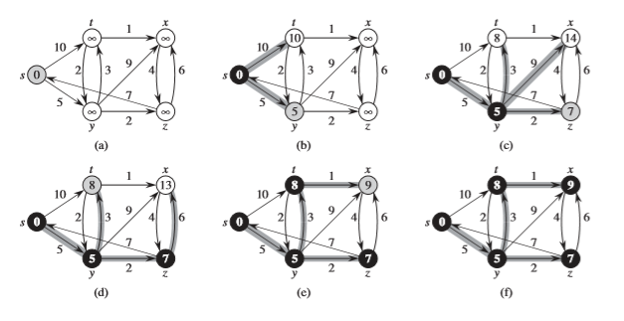
EXAMPLE :-
SINGLE SOURCE SHORTEST PATH-DIJKSTRA’S ALGORITHM

Slide 6
TIME COMPLEXITY :-
SINGLE SOURCE SHORTEST PATH-DIJKSTRA’S ALGORITHM
Dijkstra's algorithm visits every node once (=O(V)),and tries to relax all adjacent nodes via the edges.
Therefore it iterates over each edge exactly twice (=O(E)), each time accessing the priority queue up to two times in O(logV).
Therefore the complexity is O(ElogV+V).

Slide 7
BELLMAN FORD ALGORITHM :-
SINGLE SOURCE SHORTEST PATH - BELLMAN FORD ALGORITHM
The Bellman-Ford algorithm solves the single-source shortest-paths problem in the general case in which edge weights may be negative.
Like other Dynamic Programming Problems, the algorithm calculates shortest paths in a bottom-up manner.
It first calculates the shortest distances which have at-most one edge in the path.
Then, it calculates the shortest paths with at-most 2 edges, and so on.
After the i-th iteration of the outer loop, the shortest paths with at most i edges are calculated.
There can be maximum |V| – 1 edges in any simple path, that is why the outer loop runs |v| – 1 times.
The idea is, assuming that there is no negative weight cycle, if we have calculated shortest paths with at most i edges, then an iteration over all edges guarantees to give shortest path with at-most (i+1) edges

Slide 8
ALGORITHM :-
SINGLE SOURCE SHORTEST PATH - BELLMAN FORD ALGORITHM
BELLMAN-FORD(G,w,s)
INITIALIZE-SINGLE-SOURCE(G,s)
for i = 1 to |G.V|-1
for each edge (u,v) є G.E
RELAX(u,v,w)
for each edge (u,v) є G.E
if v.d > u.d + w(u,v)
return FALSE
return TRUE

Slide 9
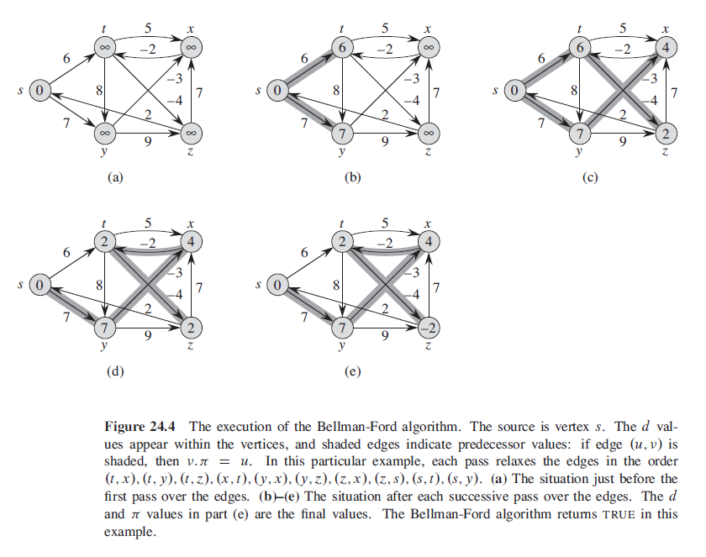
EXAMPLE :-
SINGLE SOURCE SHORTEST PATH - BELLMAN FORD ALGORITHM

Slide 10
TIME COMPLEXITY :-
SINGLE SOURCE SHORTEST PATH - BELLMAN FORD ALGORITHM
The Bellman-Ford algorithm runs in time O(VE).
Since the initialization in line 1 takes O(V) time.
Each of the |V| -1 passes over the edges in lines 2–4 takes O(E) time,
And the for loop of lines 5–7 takes O(E) time.

Slide 11
ALL PAIR SHORTEST PATH :-
ALL PAIR SHORTEST PATH
All Pair Shortest Path Problem : Find a shortest path from u to v for every pair of vertices of u and v. Although we can solve this problem by running a single-source algorithm once from each vertex, we usually can solve it faster.
The all pair shortest path algorithm is also known as Floyd-Warshall algorithm is used to find all pair shortest path problem from a given weighted graph.
As a result of this algorithm, it will generate a matrix, which will represent the minimum distance from any node to all other nodes in the graph.

Slide 12
FLOYD-WARSHALL ALGORITHM :-
ALL PAIR SHORTEST PATH - FLOYD-WARSHALL ALGORITHM
In all pair shortest path, when a weighted graph is represented by its weight matrix W then objective is to find the distance between every pair of nodes.
We will apply dynamic programming to solve the all pairs shortest path.
In all pair shortest path algorithm, we first decomposed the given problem into sub problems.
In this principle of optimally is used for solving the problem.
It means any sub path of shortest path is a shortest path between the end nodes.

Slide 13
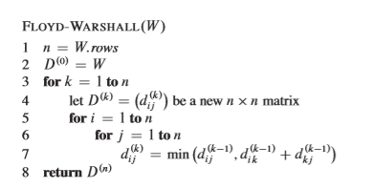
ALGORITHM :-
ALL PAIR SHORTEST PATH - FLOYD-WARSHALL ALGORITHM

Slide 14
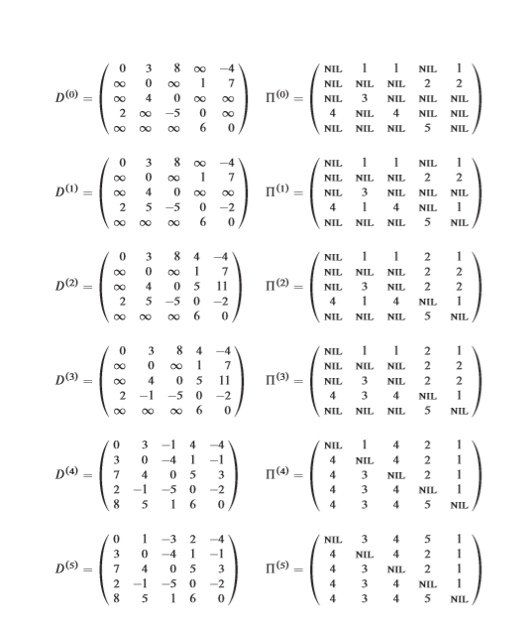
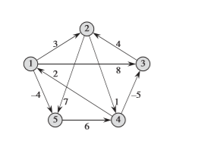
EXAMPLE :-
ALL PAIR SHORTEST PATH - FLOYD-WARSHALL ALGORITHM

Slide 15
TIME COMPLEXITY :-
ALL PAIR SHORTEST PATH - FLOYD-WARSHALL ALGORITHM
The running time of the Floyd-Warshall algorithm is determined by the triply nested for loops of lines 3–7.
Because each execution of line 7 takes O(1) time, the algorithm runs in time O(n^3).

